Slide 1

Tu BiShvat
New Year for the Trees
ט״וּ בְּשְׁבָט: רֹאשׁ הַַשָׁנָה לַאִילָנוֹת
Grades 3 and 4 • Lesson 1

Slide 2
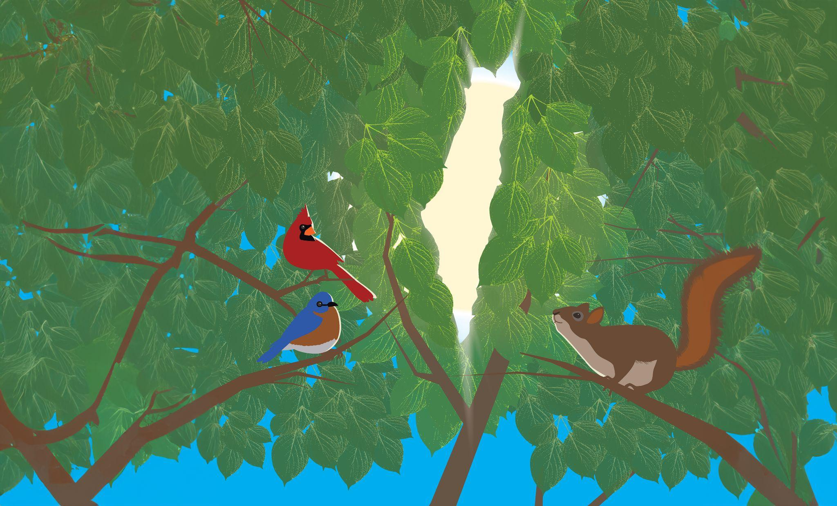
WELCOME
Notes:
Tu BiShvat
New Year for the Trees
ט״וּ בִּשְׁבָט תשפ״ג : רֹאשׁ הַשָּׁנָה לָאִילָנוֹת
Grades 3 and 4 Lesson 1 of 2
Introduction
In this first of two lessons, students will understand the meaning of Tu BiShvat ט״וּ בִּשְׁבָט and its role as one of the four new years celebrated in the cycle of the Jewish year. Students will be introduced to the themes, customs, and celebrations of the holiday and understand how it is connected to the land of Israel. They will also begin to consider ways in which we can all contribute to supporting trees and the earth.
The lesson includes activities and a variety of media, including video links and Google slides. Click here[1] to make a copy of the slides for this lesson. Slides can be projected, displayed, or printed for student use with the lesson activities.
Tu BiShvat ט״וּ בִּשְׁבָט and Jewish National Fund - USA
This 60-minute lesson is intended to set the stage for further exploration of Tu BiShvat ט״וּ בִּשְׁבָט and the Forestry and Green Innovation Projects in Israel through the Jewish National Fund-USA. Jewish National Fund-USA has planted over 260 million trees in Israel. While this is an impressive achievement, there is always a need for more due to natural forest regrowth, forest fires, and arson. We encourage every student to help continue to build up Israel by planting one or more trees.
Your school or organization will have a chance to participate in a Tu BiShvat Tree Planting Contest with schools worldwide. Tree planting is a mitzvah! Class fundraisers for trees are a tradition on Tu BiShvat and now, more than ever, are a great way for your students and families to show their commitment to a strong and healthy Israel. Each school will have a unique tree planting page. Donors, schools, and organizations will compete for a chance to win prizes. The contest will run through February 4th.
CLICK HERE TO REGISTER YOUR SCHOOL NOW
CLICK HERE TO UPDATE YOUR SCHOOL PAGE AND SEE YOUR PROGRESS
As a token of our appreciation and to honor our commitment to the land and people of Israel, Jewish National Fund-USA will plant a tree in Israel in the name of each organization that participates in our Tu BiShvat in the Schools campaign.
Lessons for grades 3 and 4 were designed by ShalomLearning curriculum consultant Alison Zimbalist with input from ShalomLearning team members.
Essential Questions
What are the four Jewish New Years, and what "new year" does each celebrate?
What is the meaning of the name Tu BiShvat ט״וּ בִּשְׁבָט?
What do we celebrate on Tu BiShvat ט״וּ בִּשְׁבָט?
What does the month of Shvat look like in Israel?
What are some ways people celebrate Tu BiShvat ט״וּ בִּשְׁבָט?
Enduring Understandings
There are four “new years” celebrated during the cycle of the Jewish calendar: 1 Nisan, 1 Elul, 1 Tishrei, and 15 Shvat.
The Hebrew calendar dates are represented by the Hebrew month and letters corresponding to Hebrew numbers.
The holiday Tu BiShvat ט״וּ בִּשְׁבָט is the Birthday of Trees, when we celebrate nature, especially trees and their fruit. It is celebrated on the 15th day of the Hebrew month of Shvat because, in the land of Israel, this is the time when trees start to bloom after the rainy season.
Tu BiShvat ט״וּ בִּשְׁבָט is celebrated by planting trees, having festive meals that feature the products of trees, and engaging in activities and thinking about ways that we can better care for the Earth.
Learning Goals
Students will become familiar with connections between the civil and the Hebrew calendar and understand that Hebrew dates are denoted using Hebrew letters with a numeric value.
Students will learn that there are four “new years” designated on the Jewish calendar.
Students will know that Tu BiShvat ט״וּ בִּשְׁבָט is the date, the 15th day of the Hebrew month of Shvat, when we celebrate the birthday of the trees.
Students will learn about connections between Tu BiShvat ט״וּ בִּשְׁבָט and the land of Israel in its timing and its celebration.

Slide 3

Understanding the Hebrew Calendar
Think about the idea of a “new year.”
What other “new years” are marked on the calendar each year?
Notes:
Understanding the Hebrew Calendar
Time Allotment: 15 minutes
Materials: English-Hebrew Calendar Wheel, list of your students’ birthdays, letter to parents
Outcomes: Students will become familiar with the Hebrew calendar and the relationship between months on the civil calendar and Hebrew months. Students will understand that Tu BiShvat ט״וּ בִּשְׁבָט means the 15th day of the Hebrew month of Shvat.
Teacher note: Your school may be able to provide the teacher with a list of the students’ birthdays and birth years. In order to determine the Hebrew date for their birthday, they will need to know what time of day they were born. Communicate with parents before the lesson to get this information. Click here for a draft of a letter you can edit to send to parents..The teacher and student can then use hebcal.com to determine the Hebrew date of their birthday and the corresponding date on the civil calendar for the current year.
Ask students to think about the idea of a “new year.” Remind students that we recently celebrated the civil (non-religious) new year of 2024 on January 1st. This new year comes every January 1st and marks the beginning of the year on the Gregorian calendar (the name for the calendar that is January 1 through December 31). The Gregorian calendar is based on the rotation of the sun. Ask: What other “new years” are marked on the calendar each year? Brainstorm a list on the board.
Students should readily identify their own birthdays and Rosh Hashanah; they may also identify that they have Hebrew birthdays as well. Guide them to also identify the new school year and other cultures’ new years (such as Chinese New Year and Enkutatash, the Ethiopian New Year).
Ask students to briefly share some of the similarities of how all of these new years are celebrated. They may point out special foods, parties or gatherings, special activities, traditional songs, and the use of noisemakers.

Slide 4

Understanding the Hebrew Calendar
The Hebrew calendar is different from the Gregorian calendar.
The Hebrew calendar is a lunar calendar,
which is based on the cycle of the moon.
Each month has about 29 days, from new
moon to new moon.
The first day of each lunar month is Rosh
Chodesh, which means “head of the month.”
This is the calendar used throughout Israel.
Notes:
Point out that the Hebrew calendar is different from the Gregorian (January through December) calendar. It is a lunar calendar, which is based on the cycle of the moon. Each month has about 29 days, from new moon to new moon. The first day of each lunar month is Rosh Chodesh, which means “head of the month.” This is the calendar used throughout Israel.

Slide 5
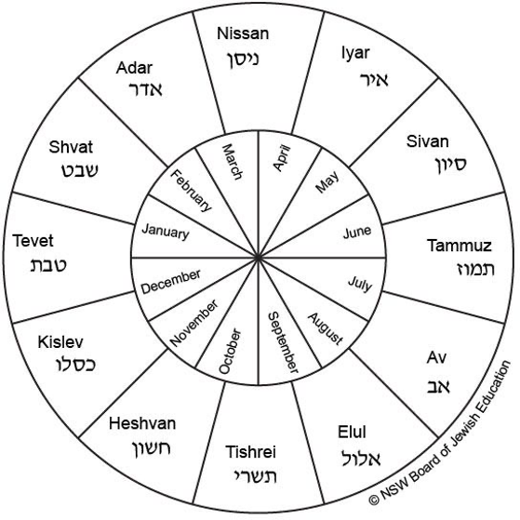
Understanding the Hebrew Calendar
Connected to the Hebrew calendar is the Jewish calendar, which tells us when holidays are celebrated, what Torah portions are assigned to each Shabbat, and other Jewish-related things having to do with days and dates.
What is the name of the new year on the Jewish calendar?
Notes:
Explain that connected to the Hebrew calendar is the Jewish calendar, which tells us when holidays are celebrated, what Torah portions are assigned to each Shabbat, and other Jewish-related things having to do with days and dates. Ask: What is the name of the new year on the Jewish calendar? (Rosh Hashanah, which means “head of the year”)
In a physical classroom distribute copies of the English-Hebrew Calendar Wheel located at the end of this lesson. Online students will see this displayed in the slide deck. Ask students to find Nisan, and point to it on the wheel. Explain that Nisan is considered the first month on the Hebrew calendar, just like January is on the Gregorian calendar. Then, read aloud the names of the Hebrew months while pointing to them on the wheel.

Slide 6

Understanding the Jewish Calendar
Notes:
Use this video and catchy tune by Ckids International to learn about the Hebrew Months of the Jewish Year

Slide 7
Understanding the Hebrew Calendar
What Hebrew month do you think we are in now, and why do you think this?
What Hebrew month is your Hebrew birthday likely in, and why do you think this?
Notes:
Ask students to look at the wheel and answer:
What Hebrew month do you think we are in now, and why do you think this? (Provide the accurate Hebrew date.)
What Hebrew month is your Hebrew birthday likely in, and why do you think this? (Provide students with their Hebrew birthdates as needed.)
Ask students to draw an icon representing a birthday (such as a cake, present, or candle) for both their English and Hebrew birthdays on the wheel. They should also write their English and Hebrew birthdates near the icons. Then, ask them to draw an icon representing January 1 (such as a party hat or noisemaker) on the wheel. Onsite students will be able to do this on their own worksheets. Online students can add to the screen with their annotation tools.
Point out that the Hebrew date of Jewish holidays does not change from year to year. Jewish holidays are celebrated each year on the very same day of the Hebrew month.

Slide 8

Four New Years Each Year!
What new years do you know about that take place in the Jewish calendar?
How many new years do you think are celebrated on the Jewish calendar?
Notes:
Four New Years Each Year!
Time Allotment: 10 minutes
Materials: Mishnah Rosh Hashanah 1:1
Outcomes: Students will learn about the four new years celebrated in the Jewish calendar and what each marks in the cycle of the year. Students will then understand Tu BiShvat ט״וּ בִּשְׁבָט as the new year for trees and its significance in marking springtime in Israel.
Ask students what new years they know about that take place in the Jewish calendar; students should readily identify Rosh Hashanah. Remind students that you’ve already discussed that in their lives they mark the beginning of several “new years” each year: aside from Rosh Hashanah, they celebrate the turn of the year on January 1, their birthday (both on the Gregorian and the Hebrew calendar), and the new school year, and maybe some others. Ask: How many new years do you think are celebrated on the Jewish calendar? Students may be surprised to learn there are four.

Slide 9
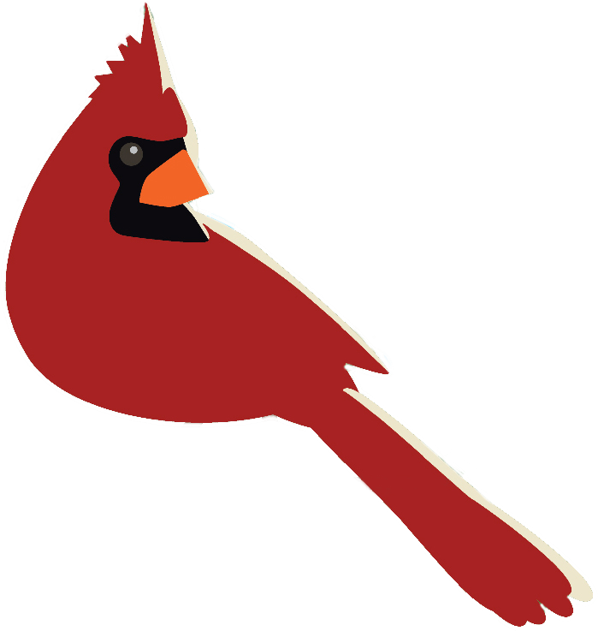
Four New Years Each Year!
Full Text of Mishnah Rosh HaShanah 1,1 (chapter 1, mishnah 1)
א אַרְבָּעָה רָאשֵׁי שָׁנִים הֵם. בְּאֶחָד בְּנִיסָן רֹאשׁ הַשָּׁנָה לַמְּלָכִים וְלָרְגָלִים. בְּאֶחָד בֶּאֱלוּל רֹאשׁ הַשָּׁנָה לְמַעְשַׂר בְּהֵמָה. רַבִּי אֶלְעָזָר וְרַבִּי שִׁמְעוֹן אוֹמְרִים, בְּאֶחָד בְּתִשְׁרֵי. בְּאֶחָד בְּתִשְׁרֵי רֹאשׁ הַשָּׁנָה לַשָּׁנִים וְלַשְּׁמִטִּין וְלַיּוֹבְלוֹת, לַנְּטִיעָה וְלַיְרָקוֹת. בְּאֶחָד בִּשְׁבָט, רֹאשׁ הַשָּׁנָה לָאִילָן, כְּדִבְרֵי בֵית שַׁמַּאי. בֵּית הִלֵּל אוֹמְרִים, בַּחֲמִשָּׁה עָשָׂר בּוֹ:
There are four “New Years”:
The 1st of Nisan is the New Year for [crowning] kings and for determining the order of the Festivals.
The 1st of Elul is the New Year for animals[‘ tithes]. But Rabbi Elazar and Rabbi Shimon say: The New Year for animals is on the 1st of Tishrei.
The 1st of Tishrei is the New Year for years, to calculate Sabbatical Years [every 7 years] and Jubilee Years [every 50 years] and for planting trees & vegetables.
The 1st of Sh’vat is the New Year for trees, according to the School of Shammai, but the School
of Hillel says: The New Year for trees is on the 15th of Sh’vat.
Notes:
Display and read aloud the following text, the very first teaching in Mishnah Rosh Hashanah:
אַרְבָּעָה רָאשֵׁי שָׁנִים הֵם. בְּאֶחָד בְּנִיסָן רֹאשׁ הַשָּׁנָה לַמְּלָכִים וְלָרְגָלִים. בְּאֶחָד בֶּאֱלוּל רֹאשׁ הַשָּׁנָה לְמַעְשַׂר בְּהֵמָה. רַבִּי אֶלְעָזָר וְרַבִּי שִׁמְעוֹן אוֹמְרִים, בְּאֶחָד בְּתִשְׁרֵי. בְּאֶחָד בְּתִשְׁרֵי רֹאשׁ הַשָּׁנָה לַשָּׁנִים וְלַשְּׁמִטִּין וְלַיּוֹבְלוֹת, לַנְּטִיעָה וְלַיְרָקוֹת. בְּאֶחָד בִּשְׁבָט, רֹאשׁ הַשָּׁנָה לָאִילָן, כְּדִבְרֵי בֵית שַׁמַּאי. בֵּית הִלֵּל אוֹמְרִים, בַּחֲמִשָּׁה עָשָׂר בּוֹ:
.
Mishnah Rosh Hashanah 1:1
(1) There are four new years:
On the first day of Nisan, which is the new year for the kings and for the festivals.
On the first day of Elul, which is the new year for the tithing of animals.
On the first of Tishrei, which is the new year for years — for the Sabbatical years and for the Jubilee years and for the planting and for the vegetables.
On the first day of Shvat, the new year for the trees, according to the words of the House of Shammai; The House of Hillel says, on the fifteenth of Shvat.
Explain and discuss this mishnah line by line:
● “The four new years are: On the first of Nisan, the new year for the kings and for the festivals;”
○ Nisan is the first month of the Jewish year. This date is found both in this mishnah and in the Torah, commanded in Exodus/Shemot 12:1-2: “This month shall be considered by you as the First of the Months; it is the First for you of the months of the year.” It corresponds to the Exodus from Egypt and the birth of the Israelite nation and Jewish national history. The counting of all Jewish religious festivals is thus tied to the Exodus. The reigns of Jewish kings also began on the first of Nisan.
○ Ask: What holiday celebrates the Exodus from Egypt and the birth of the Israelite nation, taking place in the Hebrew month of Nisan? (Passover/Pesach)
○ Have students locate Nisan on the calendar wheel and draw an appropriate icon, such as a crown or the splitting of the Sea of Reeds. They should also write 1 Nisan near their icon.
● “On the first of Elul, the new year for the tithing of animals;”
○ Explain that the word “tithe” means “one-tenth.” In the days of the Temple, one-tenth of many things were tithed for various reasons; in this case, the tithing of one-tenth of all cattle were offered to G-d. The one-tenth for each year was determined on the first of Elul.
○ Explain that because we no longer have the Temple, this new year is no longer practical.
○ Have students locate Elul on the calendar wheel and draw an appropriate icon, such as a cow. They should also write 1 Elul near their icon.
● “In the first of Tishrei. On the first of Tishrei, the new year for years, for the Sabbatical years and for the Jubilee years and for the planting and for the vegetables.”
○ 1 Tishrei is Rosh Hashanah, the Jewish new year students are most familiar with. Ask: What is the Jewish purpose of Rosh Hashanah? (We ask G-d to write us in the Book of Life and begin the Ten Days of Repentence; the last day, 10 Tishrei, is Yom Kippur, when we pray that we are sealed in the Book of Life.)
○ Point out that this part of the mishnah is also talking about agriculture and changes in the land.
■ “The Sabbatical years” refers to the seventh year, during which the land must not be cultivated. It is a “year of rest” in the same way that Shabbat, the seventh day of the week, is a “day of rest.” Leviticus/Vayikra 25:2-5: “When you enter the land that I assign to you, the land shall observe a sabbath of the Lord. Six years you may sow your field and six years you may prune your vineyard and gather in the yield. But in the seventh year the land shall have a sabbath of complete rest, a sabbath of the Lord: you shall not sow your field or prune your vineyard…it shall be a year of complete rest for the land.” Following this, in the seventh year of the cycle, people were only allowed to gather what the land could produce on its own, without cultivating the earth.
■ “...and for the Jubilee years” refers to the fiftieth year, following seven seven-year cycles of Sabbatical years. In Jubilee years, all indentured (enslaved) Israelites were allowed to return to their homes and all land that was being held or leased by someone else was returned to its original owners.
■ “...and for the planting and for the vegetables” refers to 1 Tishrei being the new year for figuring out the yearly tithe—in this case a 10% tax—on vegetables and grains.
○ Have students locate Tishrei on the calendar wheel and draw an appropriate icon, such as a shofar. They should also write 1 Tishrei, Rosh Hashanah near their icon.
● “On the first of Shvat, the new year for the trees, these are the words of the House of Shammai; The House of Hillel says, on the fifteenth thereof.”
○ This part of the mishnah refers to the holiday of Tu BiShvat ט״וּ בִּשְׁבָט, celebrated on the 15th day of the month of Shvat. Remind students that Hillel and Shammai were two great rabbis who lived about 2,000 years ago and they each had their own schools of followers (“houses”). They appear throughout the teachings of the Mishnah having peaceful disagreements about many Jewish practices, including, as we see here, when the new year for trees should be celebrated. Typically, we follow Hillel’s opinion, so Tu BiShvat ט״וּ בִּשְׁבָט is celebrated on 15 Shvat.

Slide 10
Four New Years Each Year!
On the first of Nisan, the new year for the kings and for the festivals;”
Locate Nisan on the calendar wheel and draw an appropriate icon, such as a crown or the splitting of the Sea of Reeds. Write 1 Nisan near the icon.

Slide 11

Four New Years Each Year!
“On the first of Elul, the new year for the tithing of animals;”
Locate Elul on the calendar wheel and draw an appropriate icon, such as a cow. Write 1 Elul near the icon.

Slide 12
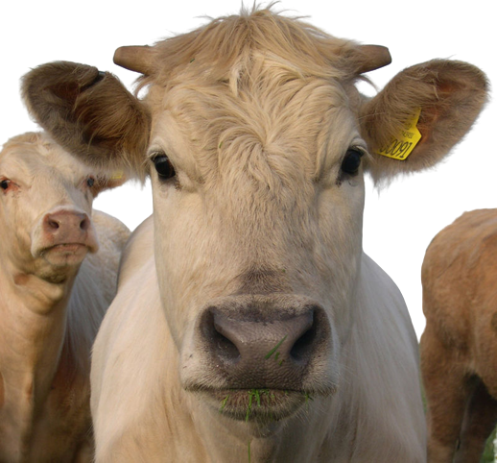
Four New Years Each Year!
The first of Tishrei, the new year for years, for the Sabbatical years and for the Jubilee years and for the planting and for the vegetables.
Locate Tishrei on the calendar wheel and draw an appropriate icon, such as a shofar. Write 1 Tishrei, Rosh Hashanah near their icon.

Slide 13
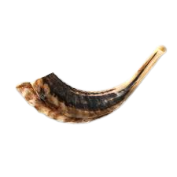
Four New Years Each Year!
“On the first of Shvat, the new year for the trees, these are the words of the House of Shammai; The House of Hillel says, on the fifteenth thereof.”
Locate Shvat on the calendar wheel and draw an appropriate icon
Notes:
Explain that you are now going to dig deeper into the holiday of Tu BiShvat ט״וּ בִּשְׁבָט, what it means to have a new year for trees, and how it is celebrated. First, have students locate Shvat on the calendar wheel and draw an appropriate icon, such as a tree. They should also write 15 Shvat, Tu BiShvat ט״וּ בִּשְׁבָט near their icon.

Slide 14
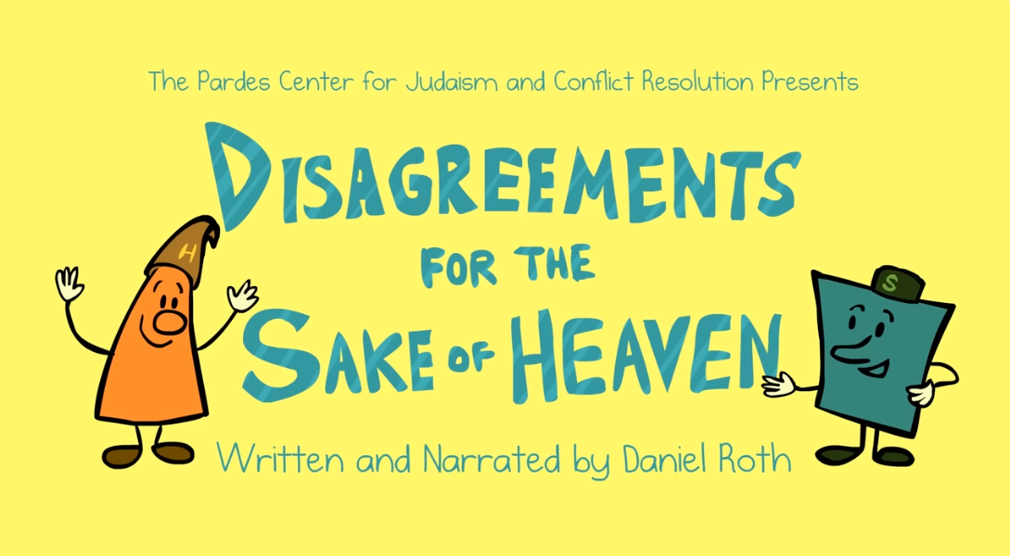

Four New Years Each Year!
Notes:
To further support students’ understanding of Hillel and Shammai, as time allows, consider showing the video “Hillel and Shammai: Disagreements for the Sake of Heaven.” https://www.youtube.com/watch?v=aL9pok2a41o

Slide 15
What Does the Name Tu BiShvat ט״וּ בִּשְׁבָט mean?
Tu BiShvat ט״וּ בִּשְׁבָט is made up of three parts: Tu, Bi, and Shvat
Why is Shvat in the name of this holiday?
Notes:
What Does the Name Tu BiShvat ט״וּ בִּשְׁבָט mean?
Time Allotment: 10 minutes
Materials: Letter and Number Chart
Outcomes: Students will understand what the name of the holiday of Tu BiShvat ט״וּ בִּשְׁבָט means by breaking down the name into three parts: Tu, Bi, and Shvat.
Explain that the name Tu BiShvat ט״וּ בִּשְׁבָט is made up of three parts: Tu, Bi, and Shvat.
Ask: Why is Shvat in the name of this holiday? (Because it takes place in the month of Shvat)

Slide 16
What Does the Name Tu BiShvat ט״וּ בִּשְׁבָט mean?
Bi = | Is a preposition. Depending on how it is used, it can mean a few different things when translated into English. In the case of Tu BiShvat ט״וּ בִּשְׁבָט, the “bi” is the Hebrew equivalent of the English word “in.” What does BiShvat mean?
Tu = | Tu actually represents the day in the month of Shvat on which the holiday falls: 15.
Notes:
Share that “bi” (sometimes seen as b’) is a preposition. Depending on how it is used, it can mean a few different things when translated into English (including in, with, among, or on). In the case of Tu BiShvat ט״וּ בִּשְׁבָט, the “bi” is the Hebrew equivalent of the English word “in.” Ask: What does BiShvat mean? (in the month of Shvat)
But, what does the first part, Tu ט״וּ mean? Tu actually represents the day in the month of Shvat on which the holiday falls: 15.

Slide 17
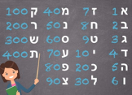
What Does the Name Tu BiShvat ט״וּ בִּשְׁבָט mean?
In Judaism we often use Hebrew letters to represent numbers.
Hebrew dates use this gematria system.
What letters make up Tu - ט״וּ?
Notes:
Display and distribute the Letter and Number Chart. Share that the Hebrew system of assigning a number for a letter is called gematria. Gematria is connected to deep Kabbalistic mystical beliefs and understandings, but they are beyond the purpose of this lesson; for our purposes, we only need to understand it as the correspondence between Hebrew letter and number.
Explain that in Judaism we often use Hebrew letters to represent numbers. Ask: Do any of you wear a “chai חי” necklace? The word “chai חי” (meaning “life”) is spelled chet-yud חי. It is associated with the number 18 because chet ח represents 8 and yud י represents 10, and 8+10=18. Eighteen and its multiples are common amounts of money that they might give or receive as gifts for birthdays, holidays, or at a B’nei Mitzvah, or donate to tzedakah. For this reason; it is considered a wish for a good life.
If your school names its classes by Hebrew letter, discuss their correlation to the Letter and Number Chart.
Share that Hebrew dates use this gematria system. As an example, point out that the date of the first of the month of Tishrei (Rosh Hashanah) would be Aleph/א Tishrei, or 1 Tishrei (instead of Echad Tishrei).
Ask: What letters make up Tu? (tet ט and vav ו) Have students find tet ט and vav ו on the chart, along with their corresponding numbers, and explain the equation: 9+6=15. Thus, Tu BiShvat ט״וּ בִּשְׁבָט is the fifteenth of the month of Shvat—the day of the holiday that Hillel ascribed in the mishnah they just studied.
Extend students’ thinking about Tu being 9+6. Can they think of an easier representation of 15? (10+5) Note that numbers 10-14 and 16-19 use this “10+” framing. So why doesn’t 15? Ask students to look at the chart and what letters represent 10 (yud י) and 5 (hey ה). Why would yud-hey not be written for 15? (Writing yud-hey in Hebrew is a representation of the name of G-d, so tet-vav is used instead.)

Slide 18
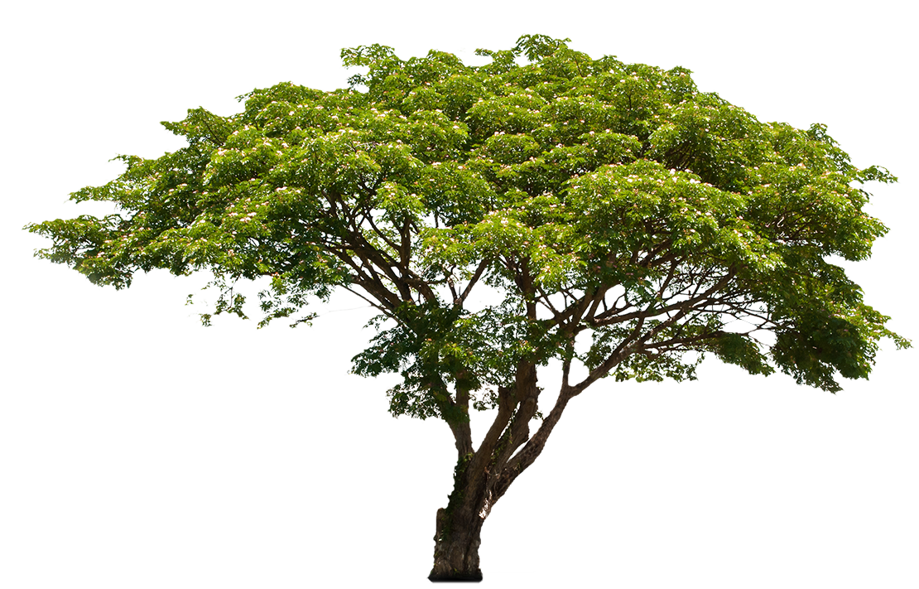
Brain Break-Be Like a Tree!
Reach branches up to the sky.
Reach branches out as far as they can.
Sway in the wind.
Drop arms to the ground, gather
the leaves in a sweep, and bring
them all up in the air.
Do the yoga tree pose, bringing hands together in
front and lifting on foot to the knee of the opposite leg.
Notes:
Optional Brain Break-Be Like a Tree!
Time Allotment: 3-5 minutes
Ask students to stand in one or more open areas of the classroom. Narrate students through some of these tree-related movements; you might also ask students to come up with their own:
Reach branches up to the sky.
Reach branches out as far as they can.
Sway in the wind.
Drop arms to the ground, gather the leaves in a sweep, and bring them all up in the air.
Do the yoga tree pose, bringing hands together in front and lifting on foot to the knee of the opposite leg.

Slide 19
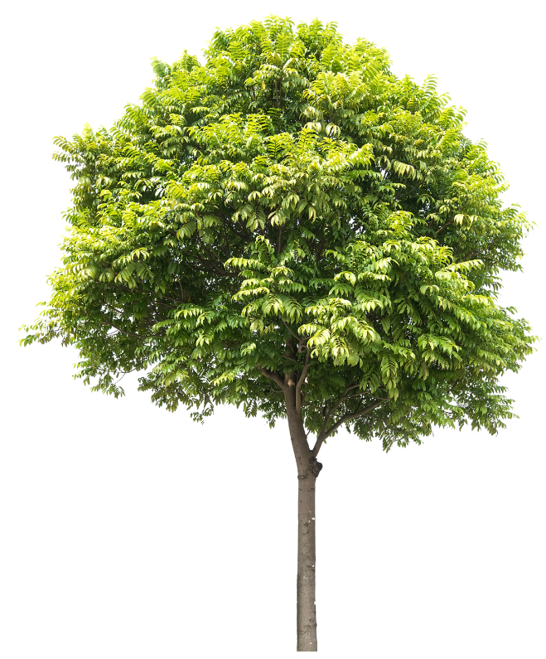
The Meaning of the Holiday of Tu BiShvat ט״וּ בִּשְׁבָט
Tu BiShvat ט״וּ בִּשְׁבָט is a celebration
of trees and fruits found in Israel. It is sometimes referred to as Jewish Earth Day or the Birthday for Trees.
Notes:
The Meaning of the Holiday of Tu BiShvat ט״וּ בִּשְׁבָט
Time Allotment: 10 minutes
Materials: Photographs of blooming almond trees and fields of red anemones; Video: “Almond Blossoms in Israel” (https://www.youtube.com/watch?v=FKCAEmDyvtI)
Outcomes: Students will understand some of the main themes of Tu BiShvat ט״וּ בִּשְׁבָט and what the month of Shvat looks like in Israel.
Tu BiShvat ט״וּ בִּשְׁבָט is a celebration of trees and fruits found in Israel. It is sometimes referred to as Jewish Earth Day or the Birthday for Trees.

Slide 20
The Meaning of the Holiday of Tu BiShvat ט״וּ בִּשְׁבָט
What months on our calendar correspond
to the Hebrew month of Shvat?
What is it like where you live in these months? What season is it where you live?
Tu BiShvat ט״וּ בִּשְׁבָט usually falls in the middle to end of February. What do the trees look like where you live then?
Notes:
Ask students to look at the calendar wheel again. Ask:
● What months on our calendar correspond to the Hebrew month of Shvat? (January/February)
● What is it like where you live in these months? What season is it where you live?
● Tu BiShvat ט״וּ בִּשְׁבָט usually falls in the middle to end of February. What do the trees look like where you live then?
Remind students that climates and seasons are different in different parts of the world. In Israel, the month of Shvat is at the end of the rainy season. At that time seeds start to sprout and trees start to flower. Seeds are the beginning of trees and flowers are the beginning of fruit. This is why Tu BiShvat ט״וּ בִּשְׁבָט is considered the new year or birthday for the trees in Israel.

Slide 21
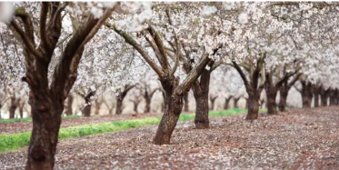
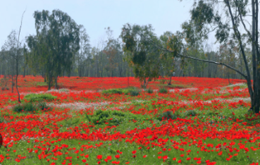
The Meaning of the Holiday of Tu BiShvat ט״וּ בִּשְׁבָט
Blooming Almond (shaked שָׁקֵד) trees
Red Anemone Coronarias
(kalanit כַּלָנִית)
Notes:
Show students pictures of the blooming almond (shaked שָׁקֵד) trees and red anemone coronarias (kalanit כַּלָנִית) at this time of year in Israel. They are like the “party decorations” for Tu BiShvat ט״וּ בִּשְׁבָט in Israel. The kalanit כַּלָנִית is the national flower of Israel.

Slide 22
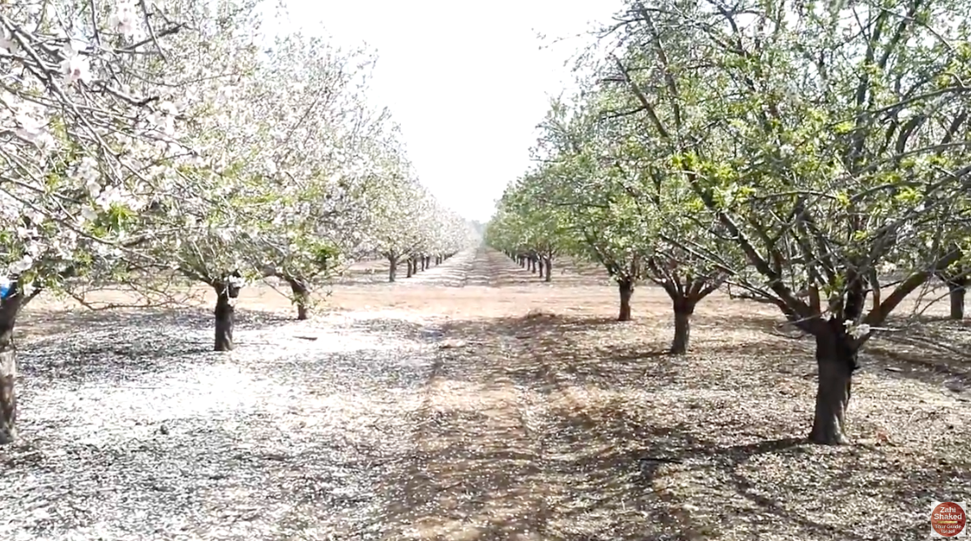
The Meaning of the Holiday of Tu BiShvat ט״וּ בִּשְׁבָט
Notes:
Show students the video “Almond Blossoms in Israel” https://www.youtube.com/watch?v=FKCAEmDyvtI to give them a sense of what it might be like to be among these trees at this time of year in Israel.
Explain that Tu BiShvat ט״וּ בִּשְׁבָט has become an environmental holiday, a celebration to remind us of the importance of nature, and a tree-planting festival for both Israelis and Jews throughout the world.Tu BiShvat ט״וּ בִּשְׁבָט.

Slide 23
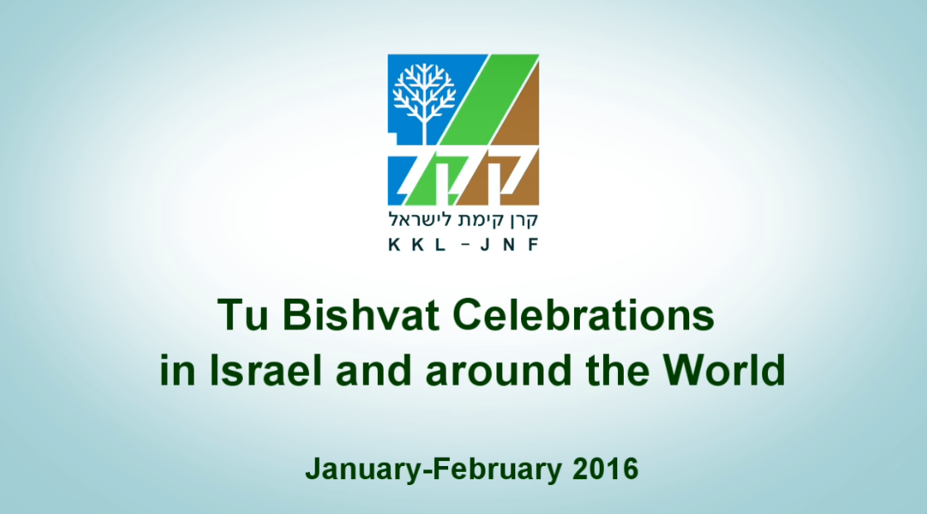
How Is Tu BiShvat ט״וּ בִּשְׁבָט Celebrated?
Notes:
How Is Tu BiShvat ט״וּ בִּשְׁבָט Celebrated?
Time Allotment: 15 minutes
Materials: Video: “A Tu Bishvat Journey through Israel and around the World” (https://www.youtube.com/watch?v=cVRRiYtK0Jc); photo of a cross-section of a tree trunk; Gifts to the Earth handout
Outcomes: Students will learn about ways that Tu BiShvat ט״וּ בִּשְׁבָט is celebrated and consider steps they might take to celebrate and care for trees and the earth.
Watch the video “A Tu Bishvat Journey through Israel and around the World” https://www.youtube.com/watch?v=cVRRiYtK0Jc to see how people in Israel celebrate Tu BiShvat ט״וּ בִּשְׁבָט. Share that this video was created in collaboration with the Jewish National Fund - USA, which works in many ways to support the land and the people of Israel, including through well-known efforts like planting trees in Israel. As students watch they should note the ways they observe people celebrating or acknowledging the holiday and share out with the class after the video.

Slide 24
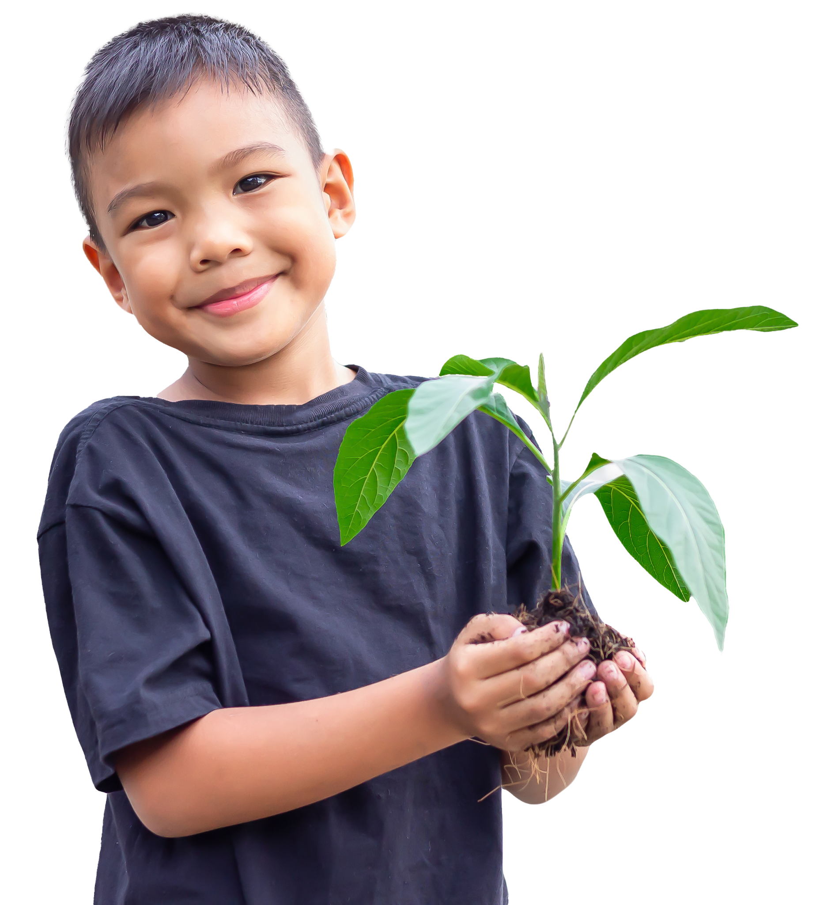
How Is Tu BiShvat ט״וּ בִּשְׁבָט Celebrated?
What types or groups of people did you see in this video?
What activities do you see?
Why might planting trees or engaging in reforestation efforts bring different groups together? What could planting a tree together represent?
Notes:
Think back to the idea of a “birthday for trees.” A birthday means you are now a year older. Do students know how we know how old a tree is? Show students a photograph of a cross-section of a tree trunk to show its growth rings.

Slide 25
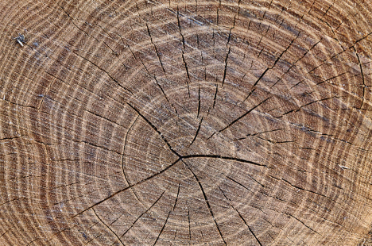
How Is Tu BiShvat ט״וּ בִּשְׁבָט Celebrated?
This is a slice of a tree trunk.
Describe what you see.
Notes:
Think back to the idea of a “birthday for trees.” A birthday means you are now a year older. Do students know how we know how old a tree is? Show students a photograph of a cross-section of a tree trunk to show its growth rings.
Explain that this is a slice of a tree trunk. Ask students to describe what they see. (They should note rings, cracks, and varying colors.) Share this explanation from the Arbor Day Foundation https://arbordayblog.org/misctrees/living-forest-tree-rings-tell-us-life-tree/:
“Every year, trees form new growth rings (also called tree rings). Not only do these tree rings tell us the age of a tree, but they also tell us climate conditions during the life of a tree. Trees add a new layer of wood between the bark and the trunk each growing season. The wood formed in spring grows faster and lighter and consists of larger cells. In the late summer, growth is slower, so the wood has smaller cells and is darker. One light ring and one dark ring represent one year of the tree’s life. Additionally, a young seedling will grow faster than a mature tree. So, growth rings may become progressively smaller as the tree ages.
Since trees are sensitive to climate conditions like temperature, moisture, and sunlight, their growth reacts to these factors. Wider tree rings may indicate a warm, wet year, whereas fine tree rings can indicate a cold and dry season. Additionally, finer tree rings may indicate distress from fire, pests, or disease.”
Allow students time to discuss ideas that they find interesting.

Slide 26

How Is Tu BiShvat ט״וּ בִּשְׁבָט Celebrated?
What do trees provide?
Why are they important?
Notes:
Ask students: What do trees provide? Why are they important? Brainstorm a list on the board.
Explain that just as trees provide for us, so too can we do things that support trees and the environment. They might think of these actions as gifts back to the earth. Distribute the Gifts to the Earth Worksheet (This worksheet will be used again in Lesson 2). Point out that the rings on this cross-section of a tree are organized as things we can all do in our homes, schools, communities, bigger cities, and the greater world that can help support trees and the natural environment. Students can work alone or with a partner to write ideas on these rings.

Slide 27
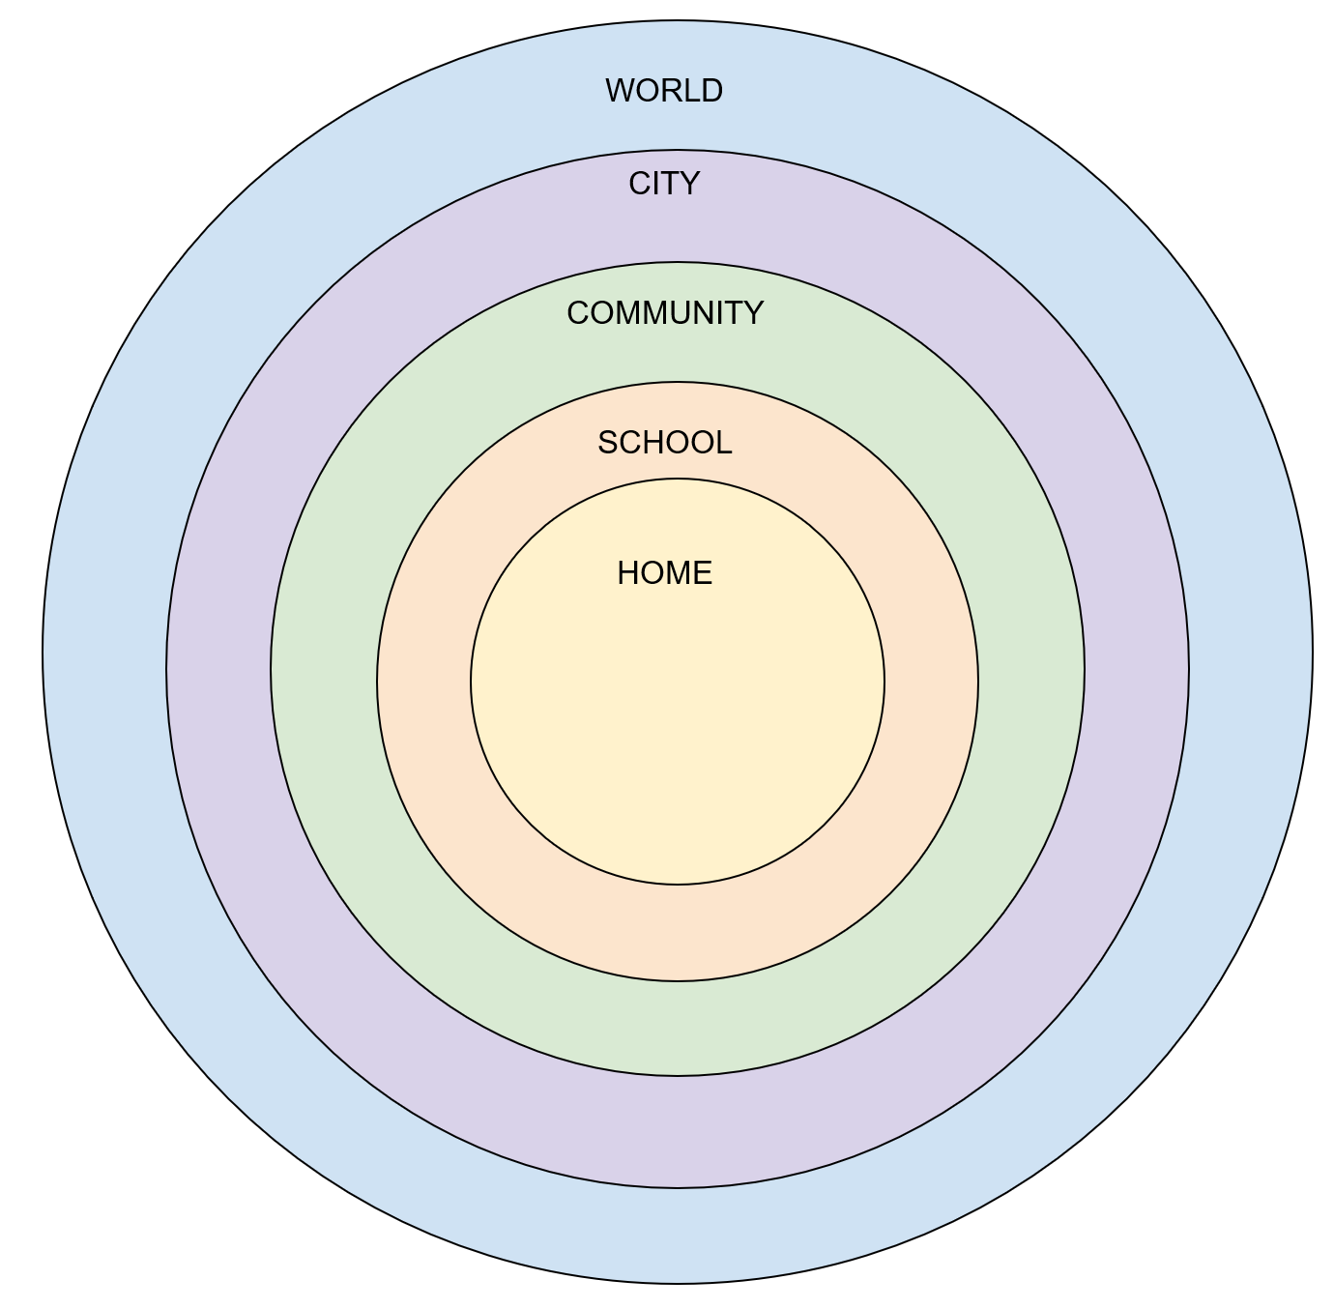
How Is Tu BiShvat ט״וּ בִּשְׁבָט Celebrated?
Gifts to the Earth
Notes:
In an online class, display the slide with the Gifts to Earth circles and have students use their annotation tools to work collaboratively to fill in the rings. Alternatively, copy the image from the slide onto a slide in Google slides, duplicate so each student has their own slide and share the link.
Explain that some of their ideas might overlap several circles.
After five minutes, call on students to share their ideas with the class. Discuss which Gifts to the Earth seem easy to accomplish and which seem harder. Which gifts are gifts that students are most likely to give.

Slide 28

Wrap Up
Share one idea you thought was interesting about today’s lesson.
Share one question you still have about the Jewish calendar.
Share one thing you still wonder about anything that was presented in the lesson or one more idea you would like to learn more about.
Notes:
Wrap-Up
● Ask students to share one idea they thought was interesting about today’s lesson.
● Ask students to share one question they still have about the Jewish calendar.
● Ask students to share one thing they still wonder about anything that was presented in the lesson or one more idea they would like to learn more about.
In the following lesson, students will expand their learning about Tu BiShvat ט״וּ בִּשְׁבָט as they draw connections to the larger concept of conservation that underscores this holiday, focusing particularly on water conservation and its critical importance in sustaining all living things—including people and trees. Students will consider the significance of water in well-known stories in the Torah, learn about water solutions that the Jewish National Fund - USA provides in Israel, and expand their thinking to their own lives by exploring what they can do to conserve water.

